Slide 1
L1 and L2 Networks

Slide 2
L1 Network Appliances
Hardware that functions on the the L1 (physical) layer (though not necessarily exclusively)
Routers
Switches
Hubs
Repeaters
If it moves traffic but doesn’t make any decisions about it, it’s L1

Slide 3
L2 Network Appliances
Hardware that functions on the the L2 (data link) layer (though not necessarily exclusively)
Routers
Switches
Responsible for sending specific frames through specific ports
Capable of determining what MAC addresses it is connected to

Slide 4
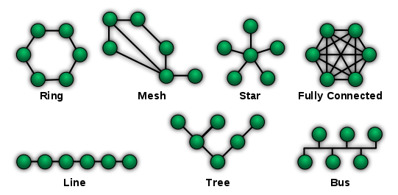
Basic Topologies

Slide 5
Data Link Layer (L2) Sublevels
The data link layer is actually broken down into two sublayers, although we typically discuss them as a single level
Logical Link Control (LLC) Layer: responsible for multiplexing, error management, and congestion management (exponential backoff)
Media Access Control (MAC) Layer: responsible for addressing data (source and destination) and encapsulation of incoming data in a frame
The logical link control typically deals with the L1 physical connection below the L2 data link layer while the media access control layer deals with the L3 IP layer (but they interface with each other to perform the L2 functionality)
Notes:
error management is done through cyclic redundancy check (CRC) which utilizes a checksum added to the end of the frame

Slide 6
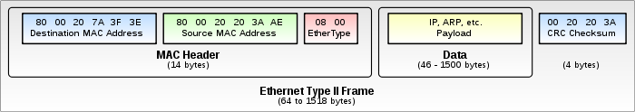
MAC Address
“Unique” and “immutable” address for a network interface set by the manufacturer used to communicate across the network
Use the ifconfig -a command to find your MAC address on Linux
Pseudo-immutable and unique because it can usually be modified
Frames contain both a source MAC address for the device creating the frame and a destination MAC address for where the frame will be sent
Notes:
It is important to specify that the MAC address is for a network interface

Slide 7
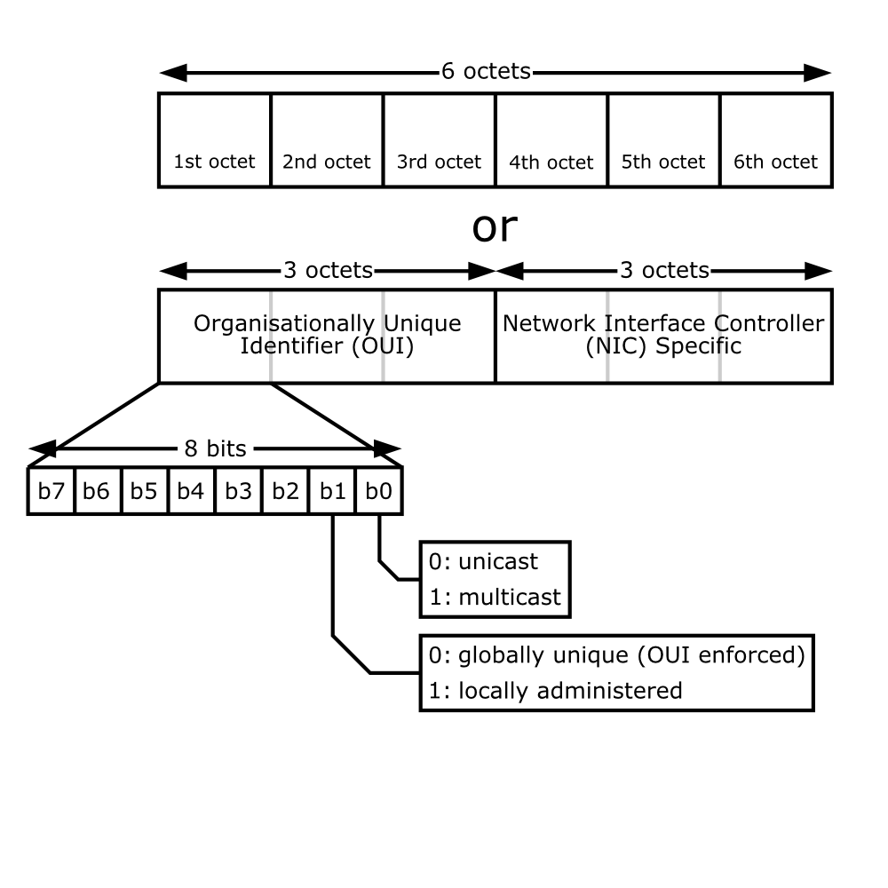
MAC Address
Specified in six groups of hex pairs separated by colons (C0:3F:0E:23:AA:C2)
The first three pairs make up the Organizational Unique Identifier (OUI) which identifies the manufacturer (C0:3F:0E)
The second three pairs make up the Network Interface Controller (NIC) which represents the device (23:AA:C2)
Notes:
There are searchable databases for OUI numbers allowing you to discover manufacturers from MAC addresses

Slide 8
Anatomy of a Frame
Preamble
Destination
Source
Type
Data
Frame Check Sequence
8 Bytes
6 Bytes
6 Bytes
2 Bytes
46-1500 bytes
4 Bytes
Preamble: synchronization, delimiter to mark end of timing info
Destination: 48-bit MAC address of destination
Source: 48-bit MAC address of source
Type: which upper layer will receive the data after Ethernet is done
Data: this is the PDU, encapsulating an IP packet
FCS: used in error detection to check for damaged frames

Slide 9
Types of Network Communication
Unicast: direct one-to-one communication between devices on a network
Broadcast: communication to all devices connected to on a network
Multicast: one-to-many communication to a subset of devices on a network

Slide 10
Switching Table
L2 communication is possible because each device that works on L2 keeps an internal switching table that lists the different MAC addresses associated with each port on the device
This allows the device to know who it can communicate with (over L2) and what port it should put the frame on to perform the communication
Record ID | Port | MAC Address
1 | 4 | 0A:5C:44:BB:81:A5
2 | 7 | 60:AB:1C:43:19:55
3 | 12 | B9:12:34:56:78:90

Slide 11
Unicast
The host (or appliance) sending the packet signs its own MAC address (which is baked in by the manufacturer) to the frame
The host (or appliance) uses its internal list of all devices connected over L2 in order to sign the destination MAC address
Because of the nature of an L2 network, every device connected to the same L2 network knows the MAC addresses of all other devices, and what network interface to use in order to communicate with that device

Slide 12
Broadcast
Protocol which sends out a packet that all devices on the network will respond to (unless otherwise configured)
Allows for hosts to discover what other devices are attached to the network, their MAC addresses, and what network interface to use to communicate with them (uses special destination FF:FF:FF:FF:FF:FF)
Broadcast is used to fill the switching tables of devices connected to the network (that are not connected directly to the device)
Notes:
Switches can also initiate their own broadcast when they receive a packet and don’t have the destination address in their switching table. When this happens they take the incoming packet and send it to devices attached to the switch (even though it isn’t signed with the special FF:FF:FF:FF:FF:FF destination). When the correct device responds the switch gets the frame in on a specific port and looks at the source address and logs it (it also logs the source address of the frame that comes in to be forwarded in the first place to get the senders MAC address). Checking source addresses of frames is how the switch updates its internal routing table.

Slide 13
Count the Broadcast Domains
R1
R2
SW1
SW2
SW3
SW4
6 Clients
9 Clients
2 Clients
5 Clients

Slide 14
Count the MACs per domain
R1
R2
SW1
SW2
SW3
SW4
6 Clients
9 Clients
2 Clients
5 Clients
Notes:
5 total broadcast domains, one per group attached to a switch with the router requiring an elevation to L3 thus defining a new network (assuming the router isn’t configured to act as an L2 switch). The routers in all likelihood also form a broadcast domain because they can broadcast to each other over L2 (typically devices operate at their layers and all layers below) but that is a bit of a tricky question.

Slide 15
Count the MACs per domain
R1
R2
2 MAC Addresses*
SW1
SW2
SW3
SW4
6 Clients
9 Clients
2 Clients
5 Clients
7 MAC Addresses
10 MAC Addresses
3 MAC Addresses
6 MAC Addresses
Notes:
Assuming the switches are not configured for VLAN (more on this later) they do not have an accessible MAC address themselves (they might for administrative reasons, but we will also ignore that for now). This means that the number of MACs per domain is equal to the number of clients attached to the switch plus 1 for the router that bridges that different networks together

Slide 16
Address Resolution Protocol (ARP)
Uses broadcasts to request the MAC address for other network interfaces on the network (usually occurring when a device knows the IP address of another machine on the network, but not its MAC address)
Sends out a broadcast request which is only responded to by the network interface specified in the request (all others ignore the request)
When network interfaces are added to the network, it can also send out an ARP announcement which is a broadcast with the broadcasters MAC address which is intended to update the switching tables of all other network interfaces on the network

Slide 17
ARP Resolution
Host 2
Host 1
Switch
Host 4
Host 5
Notes:
Start with this network topology where host 1 wants to talk with host 3 but doesn’t know its MAC address (either it knows its IP but not its MAC, or host 3 isn’t actually on the network yet, either of these will be fixed with ARP resolution or announcement)

Slide 18
ARP Resolution
Host 2
Host 3
Host 1
Switch
Host 4
Host 5
Notes:
Host 3 is attached to the network, and either it does an announcement ARP to tell everyone on the network its IP address (which is just a broadcast that tells everyone its MAC address), or it is now on the network and can be discovered through ARP

Slide 19
ARP Resolution
Host 2
Host 3
Host 1
Switch
Host 4
Host 5
Notes:
Let’s assume host 1 knows host 3’s IP address (through DNS) and wants to communicate with it but doesn’t know its MAC address, so it sends a broadcast with the IP address to the network which the switch replicates to all hosts its connected to (except the sender). The destination address in the header is FF:FF:FF:FF:FF:FF

Slide 20
ARP Resolution
Host 2
Host 3
Host 1
Switch
Host 4
Host 5
Notes:
The host with the matching IP address (which it probably gets through DHCP when connected to the network) then responds to the broadcast with a new frame with its MAC address as the source and the host 1 as the destination (it probably also caches host 1’s MAC address while it has the packet). When host 1 receives that packet it then updates its switching table with the source MAC address

Slide 21
L2 Loops and Broadcast Storms
Frames don’t have time to live (TTL) or any other mechanism to destroy them besides them reaching their destination or a dead end
Because of this any loops that exist in your L2 network can lead to broadcasts which create yet more broadcasts, think of what will happen if two switches are connected together in a loop and receive a broadcast request
These events where a single broadcast uses a loop to create a cascade of more broadcasts is known as a “broadcast storm”
To avoid this network crippling issue you need to create networks which don’t introduce any L2 loops

Slide 22
Spanning Tree Protocol (STP)
STP is a protocol for identifying and removing loops from a network and creating efficient paths for traffic to flow through
The protocol works across all L2 devices and has the following steps:
Elect a root node (configured or lowest MAC address)
Calculate the cost between each node and the root
Disable the least efficient redundant paths
Cost calculated by sending out special Bridge Protocol Data Units (BPDU) which record information about the path and cost based on throughput
Redundant paths are disabled but can become re-enabled if data can no longer use the most efficient path, allowing for redundancy

Slide 23
STP States of Ports
State changes typically happen when a faster path is identified or a path through the network fails
Forwarding: normal port operation
Blocking: no user traffic allowed, only BPDU traffic traverses this state
Learning: learns source addresses from frame, populates switching table, but no forwarding of frames through the network
Listening: processes BPDU and decides if it should move back to blocking or learning state, no population of the switching table
Disabled: not being governed by STP, set by administrator

Slide 24
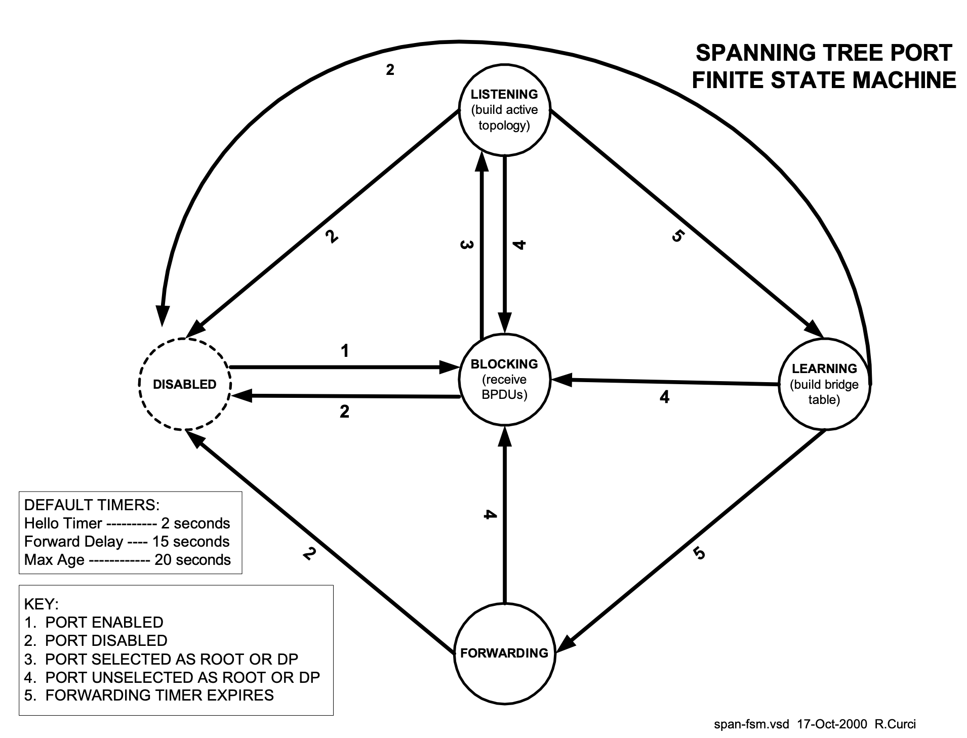

Slide 25
STP - Root Node Election
00:05
00:02
00:03
00:04
00:01
00:06
00:07
00:08
00:09
00:0A
00:0B

Slide 26
STP - Calculate Costs
00:05
2
00:02
00:03
4
2
5
6
99
20
7
00:04
00:01
00:06
1
00:07
8
9
20
3
15
7
15
00:08
8
00:09
11
00:0A
1
00:0B

Slide 27
STP - Disable Redundant Paths
00:05
2
00:02
00:03
4
2
5
6
99
20
7
00:04
00:01
00:06
1
00:07
8
9
20
3
15
7
15
00:08
8
00:09
11
00:0A
1
00:0B

Slide 28
STP - Disable Redundant Paths
00:05
2
00:02
00:03
4
2
5
6
99
20
7
00:04
00:01
00:06
1
00:07
8
9
3
15
7
15
00:08
8
00:09
00:0A
00:0B
1

Slide 29
STP - Final Topology
00:05
00:02
00:03
4
2
5
6
99
00:04
00:01
00:06
1
00:07
7
3
00:08
8
00:09
00:0A
00:0B
1
Notes:
Note that all paths that were removed in this image are actually just ports that are in the blocking state

Slide 30
Questions?

Slide 31
Additional Resources
Collision and Broadcast Domains
Address Resolution Protocol Wiki
L2 Basics: Spanning-tree Protocol
How does a switch learn MAC Addresses (Video)

